Slide 1

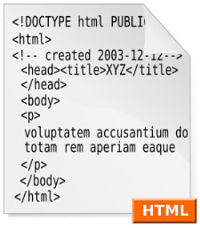



Web Technologies Basics
Concepts
Nikolay Kostov
Telerik Corporation
www.telerik.com

Slide 2

Table of Contents
Web Sites and Web Applications
Web 1.0, 2.0, 3.0
Web Browsers
Hardware Servers
Web Servers
Client-Server Architecture
3-Tier / Multi-Tier Architectures
Service-Oriented Architecture (SOA)

Slide 3
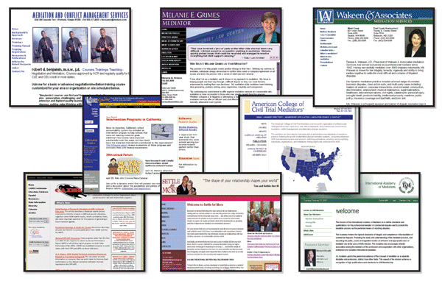
Web Sites and Web Applications

Slide 4
Web Page
Document or information resource that is suitable for the World Wide Web
Can be accessed through a web browser and displayed on a monitor or mobile device
This information is usually in HTML or XHTML format, and may provide navigation to other web pages via hypertext links
Web pages frequently refer to other resources such as style sheets (CSS), scripts (JavaScript) and images into their final presentation

Slide 5
Web Site
Collection of related web pages containing web resources (web pages, images, videos, CSS files, JS files or other digital assets)
Common navigation between web pages
A website is hosted on at least one web server
Accessible via a network (such as the Internet)
All publicly accessible websites collectively constitute the World Wide Web

Slide 6

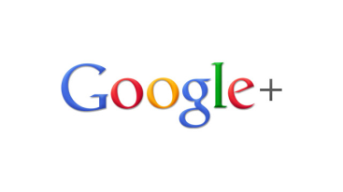
Web Application
Next level web sites
High interactivity
High accessibility (Cloud)
AJAX, Silverlight, Flash, Flex, etc.
Applications are usually broken into logical chunks called "tiers", where every tier is assigned a role
Desktop-like application in the web browser
Web applications on desktop (Windows 8)

Slide 7
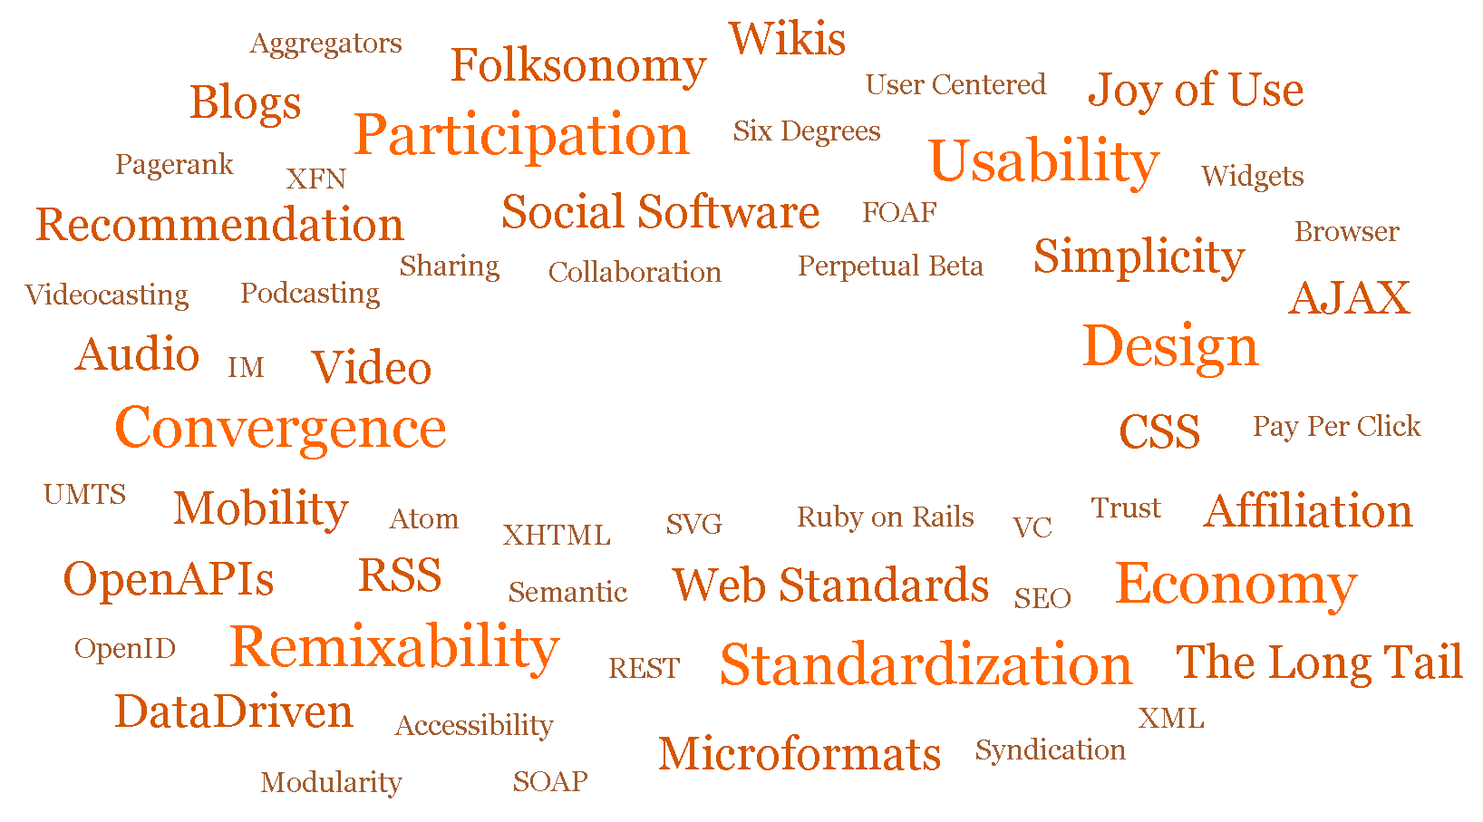
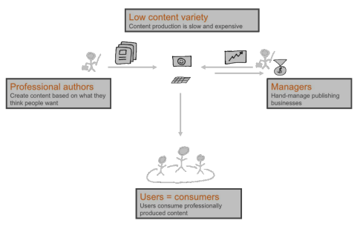
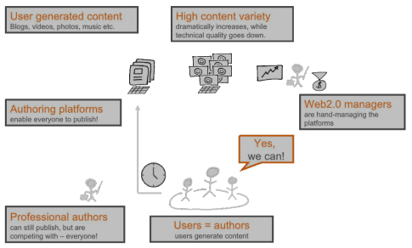

Web 1.0, 2.0, 3.0

Slide 8

Web 1.0
Old media model
It all started with a simple idea
Just put content in the web
Low content variety
Limited content
Limited creativity
Limited business
10 000 editors serve 500 000 000 internet users

Slide 9
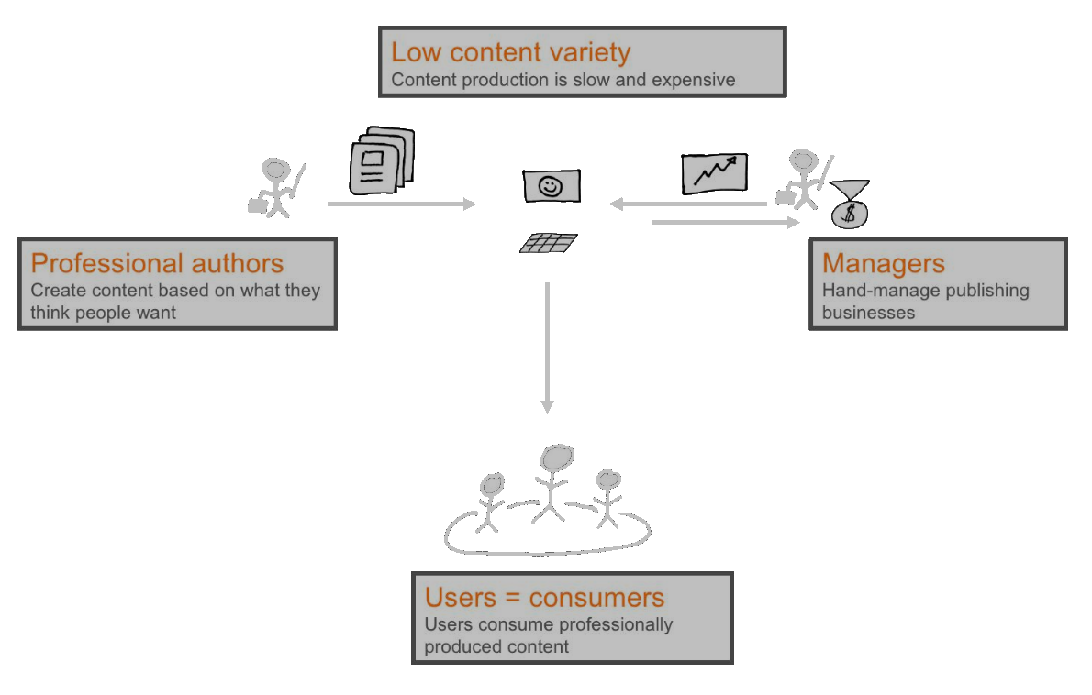
Web 1.0

Slide 10
Web 2.0

Slide 11
Web 2.0
User-generated content
New platforms allow users to generate content themselves (YouTube, Wiki, Facebook, Blogs)
Everyone can publish!
Web 2.0 can be described in 3 parts:
Rich Internet application (RIA)
Web-oriented architecture (WOA)
Feeds, RSS, Web Services, etc.
Social Web

Slide 12
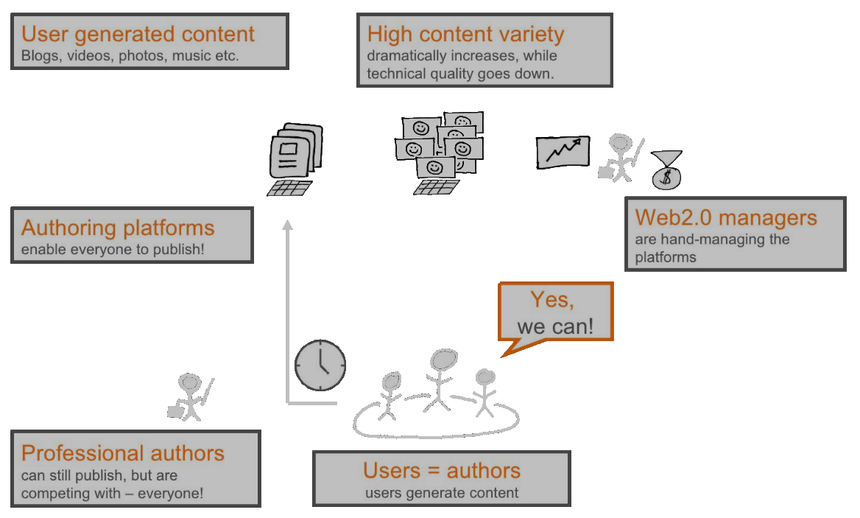
Web 2.0

Slide 13
Web 3.0

Slide 14
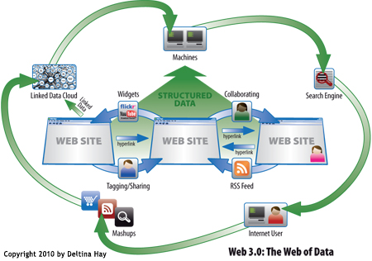
Web 3.0
Web 3.0 is where the computer is generating new information, rather than humans
All the new web 3.0 concepts can be divided into 4 parts:
Semantic web
Artificial intelligence
Personalization
Mobility

Slide 15

Web 3.0
Semantic Web
Changing the web into a language that can be read and categorized by the computers rather than humans
Makes search engines smarter
Enables digital collection of all your images, blog post, videos, etc.
Disadvantage: it is hard to be implemented

Slide 16
Web 3.0
Artificial Intelligence
Extracting meaning from the way people interact with the web
Examples: Google suggest, Google translate
Personalization
Contextualizing the web based on the people using it
Different content for different users

Slide 17

Web 3.0
Mobility
Everything
Web sites
Information
Services
Everywhere
You only need your phone or tablet
All the time

Slide 18



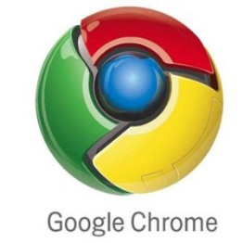


Web Browsers and Layout Engines
18

Slide 19
Web Browsers
Program designed to enable users to access, retrieve and view documents and other resources from the Web
Main responsibilities:
Bring information resources to the user (issuing requests to the web server and handling any results generated by the request)
Presenting web content (render HTML, CSS, JS)
Capable of executing applications within the same context as the document on view (Flash)

Slide 20
Layout Engines
Software component that displays the formatted content on the screen combining:
Marked up content (such as HTML, XML, image files, etc.)
Formatting information (such as CSS, XSL, etc.)
It "paints" on the content area of a window, which is displayed on a monitor or a printer
Typically embedded in web browsers, e-mail clients, on-line help systems or other applications that require the displaying (and editing) of web content

Slide 21




Layout Engines and Web Browsers
Trident-based
Internet Explorer, Netscape, Maxthon, etc.
Gecko-based
Firefox, Netscape, SeaMonkey, etc.
WebKit-based
Chrome, Safari, Maxthon, etc.
Presto-based
Opera

Slide 22
User Agent Strings
Identify web browsers and their version
Can have some additional information like layout engine, user's operating system, etc.
Example:
Web browser: Firefox 7.0.1
Rendering (layout) engine: Gecko/20100101
Operating system: 64-bit Windows 7
WOW64 = Windows-On-Windows 64-bit
Windows NT 6.1 = Windows 7
Mozilla/5.0 (Windows NT 6.1; WOW64; rv:7.0.1) Gecko/20100101 Firefox/7.0.1

Slide 23
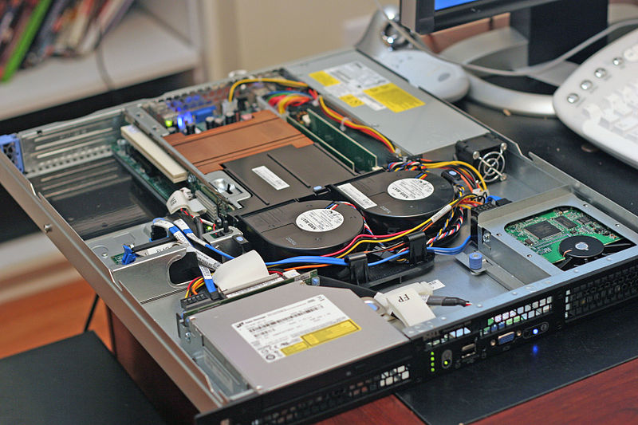
Hardware Servers

Slide 24
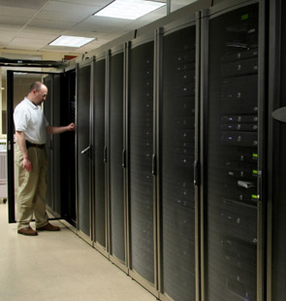
Hardware Servers
Physical computer (a hardware system) dedicated to running one or more such services
Servers are placed in collocation centers
The server may be:
Database server
File server
Mail server
Print server
VPS servers

Slide 25




Web Servers
Apache, IIS, nginx, lighttpd, etc.

Slide 26
What Do the Web Servers Do?
All physical servers have hardware
The hardware is controlled by the operating system
Web servers are software products that use the operating system to handle web requests
Web servers serve Web content
These requests are redirected to other software products (ASP.NET, PHP, etc.), depending on the web server settings

Slide 27
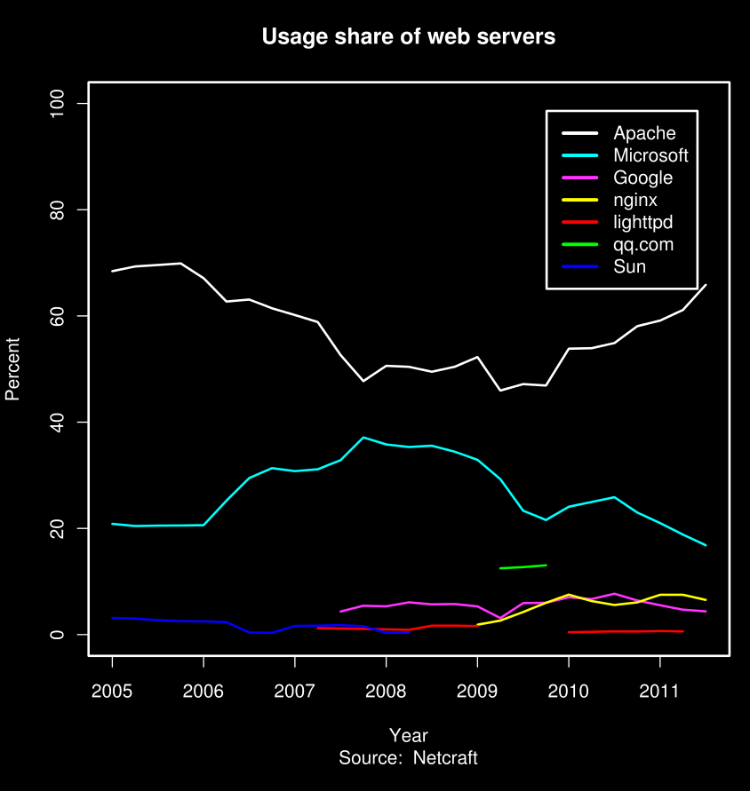
Web Servers Market Share 2011
Apache
60.31%
IIS (by Microsoft)
19.34%
nginx (by Igor Sysoev)
7.65%
GWS (by Google)
5.09%
lighttpd
0.60%

Slide 28
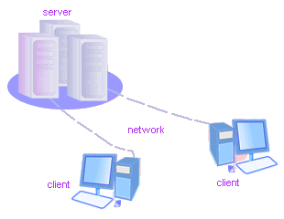
Client-Server Architecture
The Classical Client-Server Model
28

Slide 29
Client-Server Architecture
The client-server model consists of:
Server – a single machine or cluster of machines that provides web applications (or services) to multiple clients
Examples:
Web server running PHP scripts or ASP.NET pages
IIS based Web server
WCF based service
Services in the cloud

Slide 30
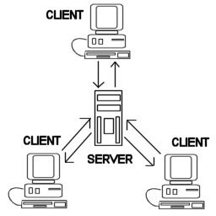
Client-Server Architecture
The client-server model consists of:
Clients –software applications that provide UI (front-end) to access the services at the server
Examples:
Web browsers
WPF applications
HTML5 applications
Silverlight applications
ASP.NET consuming services

Slide 31
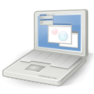
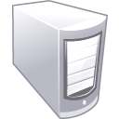


The Client-Server Model
Client
Machine
network connection
network connection
Mobile
Client
network connection
Server
Desktop
Client

Slide 32
Client-Server Model – Examples
Web server (Apache, IIS) – Web browser
FTP server (ftpd) – FTP client (FileZilla)
EMail server (qmail) – email client (Outlook)
SQL Server – SQL Server Management Studio
BitTorrent Tracker – Torrent client (μTorrent)
DNS server (bind) – DNS client (resolver)
DHCP server (wireless router firmware) – DHCP client (mobile phone /Android DHCP client/)
SMB server (Windows) – SMB client (Windows)

Slide 33
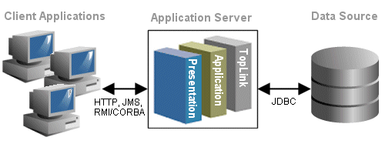
3-Tier / Multi-Tier Architectures
Classical Layered Structure of Software Systems

Slide 34
The 3-Tier Architecture
The 3-tier architecture consists of the following tiers (layers):
Front-end (client layer)
Client software – provides the UI of the system
Middle tier (business layer)
Server software – provides the core system logic
Implements the business processes / services
Back-end (data layer)
Manages the data of the system (database / cloud)

Slide 35

The 3-Tier Architecture Model
Data Tier
(Back-End)
Middle Tier
(Business Tier)
Client Tier (Front-End)
Client
Machine
network
network
Mobile
Client
network
Database
Business
Logic
Desktop
Client

Slide 36

Typical Layers of the Middle Tier
The middle tier usually has parts related to the front-end, business logic and back-end:
Presentation Logic
Implements the UI of the application (HTML5, Silverlight, WPF, …)
Business Logic
Implements the core processes / services of the application
Data Access Logic
Implements the data access functionality (usually ORM framework)

Slide 37
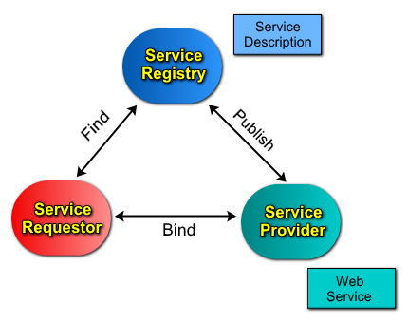

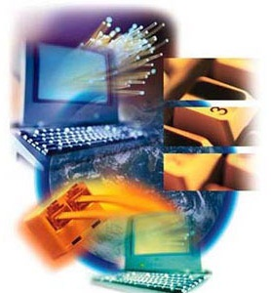
Service-Oriented Architecture (SOA)

Slide 38
What is a Service?
In the real world a "service" is:
A piece of work performed by a service provider
Provides a client (consumer) some desired result by some input parameters
The requirements and the result are known
Easy to use
Always available
Has quality characteristics (price, execution time, constraints, etc.)

Slide 39





What is "Cloud"?

Slide 40
What is Cloud?
Cloud ≈ multiple hardware machines combine their computing power and resources
Share them between multiple applications
To save costs and use resources more efficiently
Public clouds
Provide computing resources on demand
Publicly in Internet
Paid or free of charge (to some limit)
Amazon AWS, Google App Engine, Microsoft Azure, Rackspace, PHPFog, Heroku, AppHarbor

Slide 41
Cloud Computing Models
Infrastructure as a Service (IaaS)
Virtual machines in the cloud on demand
Users install the OS and software they need
Platform as a Service (PaaS)
Platform, services and APIs for developers
E.g. Java + JBoss + JSF + JPA + MongoDB or JavaScript + Node.js + MongoDB + RabbitMQ
Software as a Service (SaaS)
Hosted application on demand (e.g. WordPress)

Slide 42
Web Technologies Basics
?
?
?
?
?
Questions?
?
?
?
?
?
http://academy.telerik.com

